Slide 1


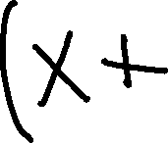
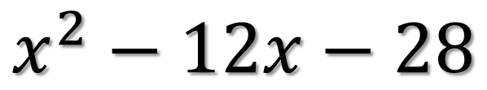


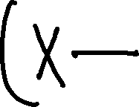
PDN
Find the error
$$x^{2}−12x−28$$

Slide 2
6.2Difference of two squares

Slide 3
Difference of Two Squares
There must be two terms that are both squares
  Examples of squares
There must be a minus sign between the two terms

Slide 4
Perfect Squares
1² = 1 11²= 121
2² = 4 12² = 144
3² = 9 13² = 169
4² = 16 14² = 196
5² = 25 15² = 225
6² = 36 16² = 256
7² = 49 17² = 289
8² = 64 18² = 324
9² = 81 19² = 361
10² = 100 20² = 400

Slide 5
Factoring Difference of
Two Squares Formula
A² – B² = (A + B)(A – B)

Slide 6
Ex. 1)

Slide 7
Ex. 2)

Slide 8
Ex. 3)

Slide 9
Ex. 4)

Slide 10

Try These
${1) x}^{2}−25$
${2) x}^{2}−81$
${3) 4z}^{2}−49$

Slide 11
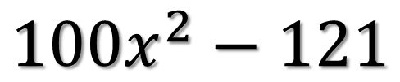
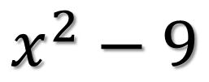
Ticket Out the Door
$$x^{2}−9$$
$${100x}^{2}−121$$
Rate yourself as +, -, or o.

